Slide 1
Customer Analysis
Marketing (MKTG) 711 – WEMBA East
@amreed2
@amreed2

Slide 2
The Course is Divided into Four Sections
STPM – Segmentation, Targeting, Positioning and Messaging
Part I:
Part II:
Part III:
Part IV:
Segmentation: Building a Customer Profile
Targeting: Gathering Information About Your Chosen Segment
Positioning: Putting Product into Consumer Minds
Messaging: Talking to Your Customers

Slide 3
General Course Information
By exploring and discussing these critical components of marketing, we formulate a strategic roadmap, a customer analysis “playbook” of sorts. As the theoretical concepts “settle in” we substantiate them by executing a specific application and corresponding analytical tool. The application is to actually “see” these concepts come to life in the context of what is often a “messy real world.”
This course is built around the mantra of “learning by doing.”
The approach that I have adopted is to create a structure (STPM), and within that structure, iterate from theory to practice.

Slide 4
Grading:
Class Participation: 40 Points
Attendance and Contributions to Class Discussion
Class Exercises: 30 Points
Memory Exercise 10 Points
Case Write-Up: FlavaNaturals 20 Points
Quantitative Analysis Tools:* 30 Points
*Analytical Tool #1 10 Points
*Analytical Tool #2 10 Points
*Analytical Tool #3 10 Points
*Analytical Tool #4 10 Points
*You may skip turning in one of the analytical tools WITHOUT penalty.

Slide 5
Grading:
Guest Speaker Assessments 15 Points
Guest Speaker #1 10 Points
Guest Speaker #2 10 Points
Guest Speaker #3 10 Points
Group Project 45 Points
PowerPoint Slide Deck 30 Points
Presentation (15 minutes – 10 Pres 5 Q&A) 15 Points
Total 160 Points

Slide 6
Grading:
Students will learn HOW TO address each area using a specific managerial framework and an analytical tool. Cumulative learning will be applied to a Group Project Analysis that touches on one or more of the areas of (STPM) for a specific company.
NOTE on class content: Some of the analytics (e.g., Logistic Regression, Cluster analysis, ANOVA, Chi-Square analysis) partially overlap with statistical content from other marketing courses (e.g., Marketing Research), but our emphasis will be on how to use them to understand customers better. This is a drill down course that builds on concepts from the core marketing intro classes. It also dovetails nicely with the Marketing Strategy and The Branding courses.
NOTE on class decorum: Bring your nameplates to class every day (so I can learn who you are!). Please don’t distract your colleagues with electronic device usage. Please use laptops during class only for note taking and analytical tool exercises.

Slide 7
Grading Notes (Please Read Carefully):
Class Participation
Attendance and Contributions to Class discussion: I will separately rate your contribution to class based on your attendance, the quality of your comments during class discussions, your level of engagement with the course materials in and out of class.
Class Exercises: Throughout the semester, as part of class engagement and class demonstrations, you will be asked to complete a few class exercises. These may range from simple very short questionnaires that demonstrate concepts in class, to online exercises that bring concepts alive. Typically, this will be an “all or none” assessment. You either do the assignment by the deadline and get full credit, or do not and get no credit.
Analytical Tools: As part of the course, and the group project, I will teach you four quantitative customer analysis tools to use. For these sessions, we will use your laptops and either excel or a statistics program to complete the analysis. You will turn in four short write ups based on these analyses, demonstrating to me that you know how to apply and interpret the method. You are allowed to miss turning in ONE of these without penalty.

Slide 8
Grading Notes (Please Read Carefully):
Class Participation (cont.)
Guest Speakers: I will have a few experts come in to present state of the art knowledge in areas of our class. You will evaluate their guest lectures and if you attend the lecture and are engaged in the lecture, you will receive points. Again, this assessment is an “all or none” point assignment.
Group Project
The group project is the culmination of the class to see if you truly have grasped the class concepts in total, and if you can apply them to a real-world situation and real world company. The group project is designed to provide a hands-on opportunity to collaborate on a real world branding/consumer/marketing situation. Team members typically receive the same grade, although adjustments will be made if necessary based on instructor and peer assessment of contributions to team work.

Slide 9
Course Schedule
Introduction
Date
Time
Topic
Friday, August 30th
1:30-4:30pm
Introduction to course
Part I: Segmentation – Building a Customer Profile
Date
Time
Topic
Friday, August 24th
9:00-12:00pm
Demographic Segmentation Analytical Tool #1
4:15-6:15pm
Group Project Introduction and Scope
Consumer Identity and the Self
Psychographic Segmentation

Slide 10
Course Schedule
Part I: Segmentation – Building a Customer Profile (cont.)
Date
Time
Topic
Friday, September 28th
4:45pm-6:45pm
Analytical Tool #2
Guest Speaker
Part II: Targeting – Gathering Information About Your Segment(s)
Date
Time
Topic
Saturday, September 29th
1:00pm-4:00pm
Marketing Intelligence Part 1
Measuring Customer Attitudes
Friday, October 26th
9:30am-12:30pm
Analytical Tool #3
Group Project Work Time

Slide 11
Course Schedule
Part III: Positioning – Putting Product into Consumer Minds
Date
Time
Topic
Saturday, October 27th
1:00pm-4:00pm
Exposure Perception and Attention
Guest Speaker
Friday, November 16th
9:30am-12:30pm
Case Analysis: Flava Naturals LIVE Build a Market/Brand
Group Project Work Time

Slide 12
Course Schedule
Part IV: Messaging – Talking to Your Customers
Date
Time
Topic
Saturday, November 17th
1:00pm-4:00pm
Memory and Retrieval
Using Rational, Emotional and Social Appeals
Friday, December 7th
1:30pm-4:30pm
Analytical Tool #4
Guest Speaker

Slide 13
Course Schedule
Part IV: Messaging – Talking to Your Customers (cont.)
Date
Time
Topic
Friday, December 21st
9:30am-12:30pm
Group Project Presentations
Saturday, December 22nd
1:00pm-4:00pm
Course Wrap-Up Lecture

Slide 14
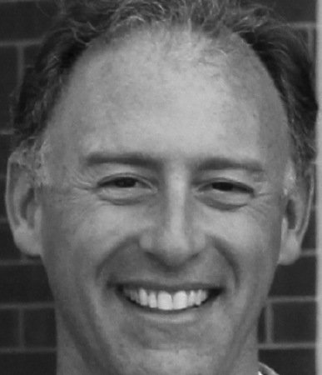
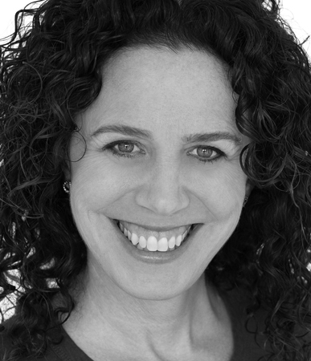
Guest Speakers
Alan Frost is the Founder and CEO of FlavaNaturals, a company that is changing the way people think about and consume chocolate. Alan combines more than 20 years of experience in the biotech industry with a commitment to healthy living and a love of chocolate.
What began in October 2014 with reading an article about a Columbia University study that linked chocolate consumption with enhanced memory led to a three-year quest to develop delicious, naturally sourced, high-flavanol chocolate that promotes wellness, performance, and achievement. The result is two breakthrough chocolate products, FlavaBars and FlavaMix, which deliver 5X to 9X the plant based cocoa flavanol anti-oxidants of a typical dark chocolate bar.
Alan has a strong track record of launching successful brands, achieving business objectives and creating shareholder value for biotech and pharmaceutical companies. Alan was most recently SVP of Commercial and Head of the TYSABRI Franchise at Elan Pharmaceuticals. Alan holds an MBA from the Wharton School at the University of Pennsylvania and a BS from the University of Delaware.
Beth Lorge is Head of Marketing at FlavaNaturals, a company that is changing the way people think about and consume chocolate. FlavaNaturals recently launched two delicious, naturally sourced, high flavanol chocolate products, FlavaBars and FlavaMix, which deliver 5X to 9X the cocoa flavanol antioxidants of a typical dark chocolate bar. As Head of Marketing, Ms. Lorge has spent the past three years developing the brand identity, packaging, messaging, consumer targeting, publicity, digital and social media strategies and brand partnerships. Chocolate was your weakness. With FlavaNaturals, it's your strength!
Beth has worked for more than twenty years as an Entrepreneur and Marketing Executive with a focus on brand development. An avid music lover, Beth is the Founder of national concert promoter Kidrockers and a founding partner of NYC record label Innit Recordings (Charles Bradley, James Levy, Lolawolf). She was previously a Vice President of American Express, Strategic Marketing Consultant at Accenture and Account Executive at Ogilvy & Mather Direct. Beth holds a BA from Brown University and an MBA in Marketing and Finance from the Wharton School at the University of Pennsylvania.

Slide 15
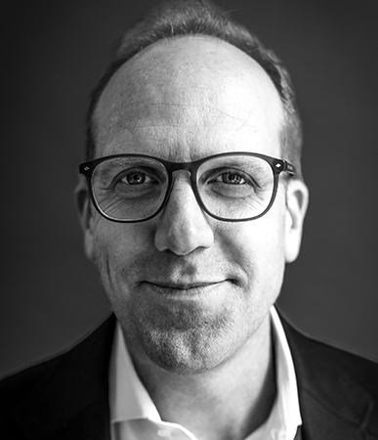
Josh Feldmeth is a Senior Partner with over 20 years of helping companies maximize the economics of their businesses. Combining a diverse skill set (corporate strategy, analytics, CX optimization, process improvement, design integration) with a CEO-perspective, his work focuses on revenue growth/margin expansion by linking clients’ strategic assets to in-market opportunities. He has lived and worked around the world and with industry leaders (e.g. AT&T, GE, Credit Suisse, BMW, Target, Roche, Emerson, Apollo, UPS) to sharpen corporate purpose, re-shape operating portfolios, shape internal cultures and build compelling, cohesive and technology-supported brand ecosystems.
After 3 years with an automotive start up and an MBA, Josh worked in the strategy practice at PwC, serving retail and CPG clients. He deepened his discipline and leadership tool kit over 14 years and in 4 offices at Interbrand where he was VP Strategy at DesignForum, built a regional analytics practice (Europe), turned around a struggling office (Amsterdam), drove double digit Rev/EBIT growth in the HQ office (New York), sold a software business and ran a regional portfolio of businesses that accounted for >90% of the firm’s profits (North America). During his Interbrand tenure, Josh’s client work increasingly focused on partnering with CEO’s, CMO’s and their teams to drive business transformation and create incremental value through corporate assets (M&A, brand repositioning, CX creation, GTM acceleration, digital platforms).
A regular contributor to business media (CNBC, Bloomberg, Wharton Radio) and a frequent business school lecturer (Stanford, Yale, Wharton, Texas), he has written extensively on how companies create value by shortening the distance between business strategy and positive customer outcomes across categories.
He has a BA from Wheaton College (IL), and MBA from the University of Texas, Austin, and lives in Connecticut with three daughters and his wife, Margaret.
Andrew Macum As Senior Analytics and Insights Director, Andrew has worked with top companies including MetLife, Ford, AT&T, Intel, Northwestern University, and Mayo Clinic. Andrew leads Prophet’s marketing sciences and analytics group supporting organizations in establishing world-class insights and analytics functions, leveraging analytical expertise to build predictive models to guide business decisions, and understanding of research design to build insights gathering tools (quant / qual research) that address pressing client needs. Most recently his work has focused on building econometric models and what-if tools to prioritize investment decisions, customer segmentation to guide positioning and value proposition development, and insights & analytics team operating model creation.
Prior to joining Prophet, Andrew was a Senior Consultant at Millward Brown Vermeer. Client engagements for brands like Visa, MasterCard, Citigroup, Hershey’s, Brown-Forman, Jack Daniels, and Marriott included choice modeling, market segmentation, market entry/sizing, brand architecture, portfolio mapping, and brand valuation. His research has appeared in Cornell’s Rationality and Society among other academic & trade publications.
Andrew is a graduate of Duke University.

Slide 16
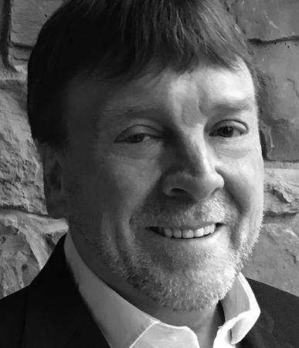
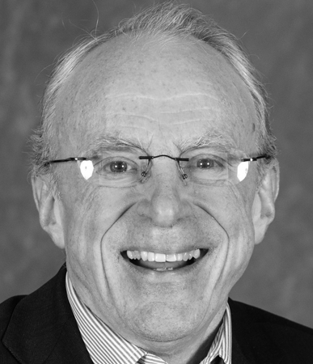
David Hoover With over two decades of experience working for a Fortune 500 consumer goods company in both Insights and Marketing roles, David has extensive expertise in global research, with an emphasis on emerging markets. David has a proven track record in innovation, and he has developed and launched over 50 innovations across 10 markets with combined year 1 sales of over $2B.
David has extensive experience in both qualitative and quantitative research methods, and his broad research toolkit ranges from moderating and facilitating to in-depth data analytics. His many years on the client side have given him a great understanding of clients’ needs, and have honed his ability to identify what strategies and tactics will move a business forward. He is especially well-versed in food categories globally; in addition, he has worked on other FMCG categories as well as durable goods and technology.
David is an avid musician, physics geek, and a huge sci-fi fan. He is beginning to think that maybe his wife is right, perhaps one can own too many guitars. On second thought, that is just blasphemy…
Dr. Rob Britton Rob has spent his entire working life, 50 years, in and near the airline industry, mainly in marketing and planning roles. He was part of the team that helped rebuild the American Airlines brand after the 9/11 terrorist attacks, led the airline’s corporate communication group, and served in a range of other roles. His marketing presentations are thus rooted with deep experience in a complex and commoditized industry.
Rob earned a Ph.D. in geography from the University of Minnesota, and a postdoctoral certificate from Wharton. Originally a geography professor, he is now an adjunct marketing professor at Georgetown University, and annual guest lecturer at more than 25 B-schools worldwide, including Kellogg, London Business School, and the Stockholm School of Economics. He has published more than 125 articles in prominent newspapers and magazines, travel-industry publications, and refereed academic journals such as MIT Sloan Management Review (forthcoming).

Slide 17
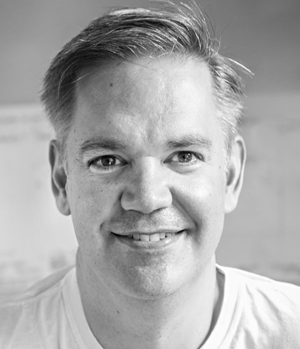
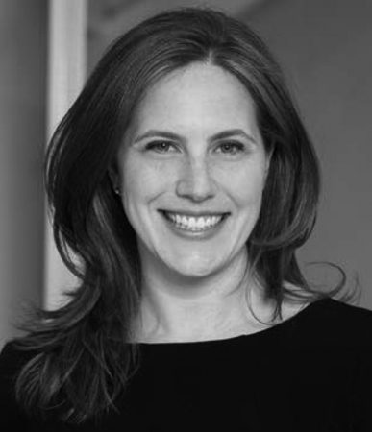
Ted Wright The CEO of Fizz, Ted Wright has been at the forefront of word of mouth marketing since he helped reignite the Pabst Blue Ribbon brand in 2000. Ted leads his crew of professionals from Fizz’s headquarters in Atlanta. Over the last decade, Fizz has become the global leader in word of mouth marketing.
A 20-year marketing veteran and an alumnus of Booz Allen Hamilton, Ted also holds an MBA with honors from The University of Chicago, enjoys great bourbon and drives too fast.
Elizabeth Windram is the Vice President of Marketing for JetBlue, New York’s Hometown Airline® and one of the world’s most acclaimed airlines.
In her role, Windram leads the airline brand strategy, including advertising, content and social media, digital marketing, regional marketing, loyalty and product development. Previously, Windram was JetBlue’s Director of Brand and Advertising where she was instrumental in many of the airline’s recent campaigns, including FlyBabies, Check In For Good, and Little Tickets.
In 2016, she received Adweek’s Grand Brand Genius award.
Before joining JetBlue, she spent seven years at E&J Gallo Winery where she led brands including Barefoot Wine & Bubbly and New Amsterdam Gin and Vodka. She started her career in finance as a investment banker in Citigroup Global Markets’ leveraged finance group and then at Terra Firma Capital Partners in London.
Windram serves on the board of the VH1 Save the Music Foundation.
Born and raised in New York City, Windram attended Stuyvesant High School. She holds an MBA from Wharton and has a BA in Economics from Duke University.

Slide 18
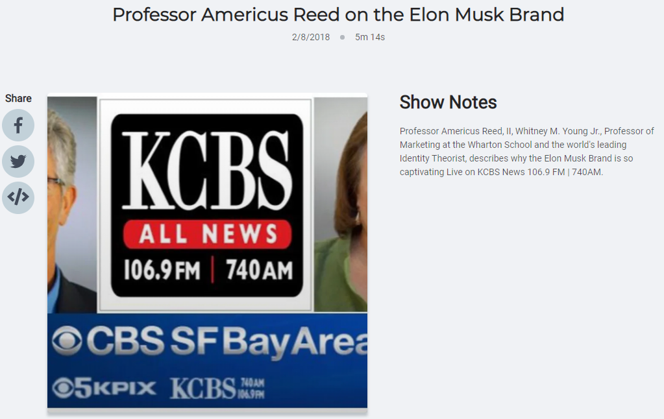
Podcast Pause
Originally aired on KCBS News 106.9 FM | 740 AM(*)

Slide 19
Podcast Pause
Personal Branding at a high level
Elon Musk—created a brand, “quirky, science fiction based, futurist, optimist, seeing things others cannot see” creates an aspirational self to elevate the brand
Customers are not just buying “Teslas” – they are buying into Elon Musk’s “vision”
CEOs have to be “brands” now—this is a new skill. Need to be good at social media
It is a double-edged sword. Iconic companies w iconic CEOs are now co-branded—hard to disentangle when brand is under crisis
> However, the buck stops here when the CEO’s brand is part of the company brand
Originally aired on KCBS News 106.9 FM | 740 AM(*)

Slide 20
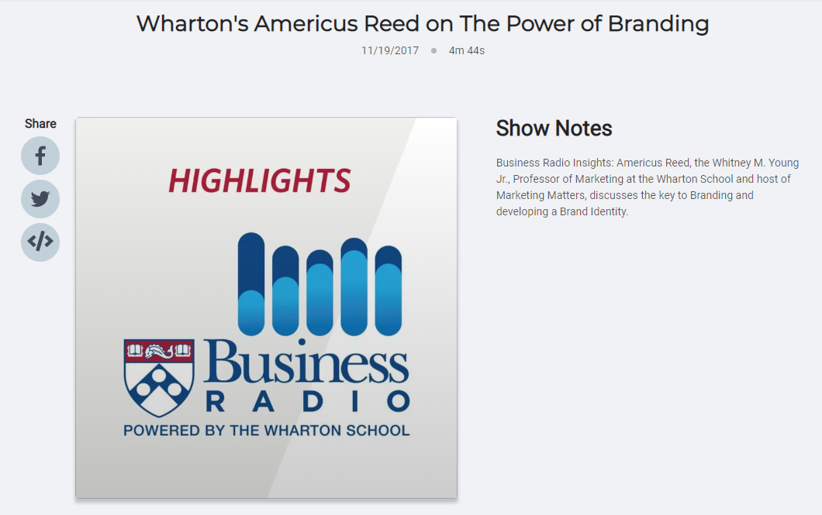
Podcast Pause
Originally aired on Business Radio powered by Wharton

Slide 21
Podcast Pause
It’s important to understand that your logo and brand are not the same thing
Your logo is a outward facing component of your brand
Your brand is much deeper-it’s creating a rich, consistent, clear meaning system. It defines what you stand for
Think about brands such as Nike, Google, Disney, Ford, Starbucks, and Apple- what makes them iconic?
Good branding is branding plus creating something that differentiates you from your competitors
It connects you to your customers to create loyalty
It creates a sense of identity and connection to create an aspirational self
Once that deep connection is made you create a powerful switching cost that essentially protects your brand and draws them into to everything you do
Originally aired on Business Radio powered by Wharton

Slide 22
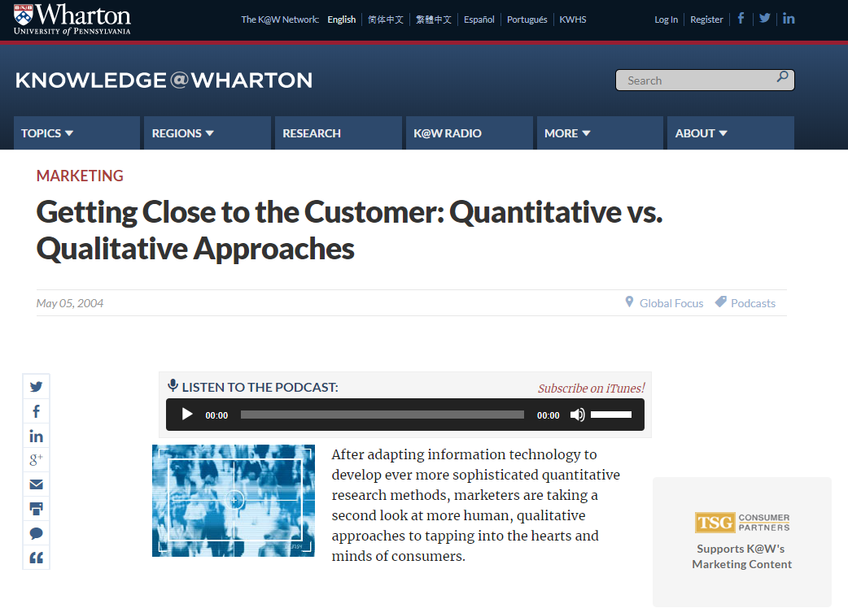
Podcast Pause
Originally aired on Business Radio powered by Wharton

Slide 23
Podcast Pause
Continual improvements in technology has given marketers more quantitative data on their customers but some struggle on how to use it
Marketers needs to find the balance between using data and insights based on their goals
Walmart more focused on the cost side and is less concerned with customer intimacy
Whirlpool and Proctor and Gamble using customer information to build concept banks to drive new product development
A balance between new and old market research techniques are being used to gather qualitative data
Projective opinions and attitudes
The Harley-Davidson approach (brand communities)
Split-Cable system
Customer Advisory boards
Originally aired on Business Radio powered by Wharton

Slide 24
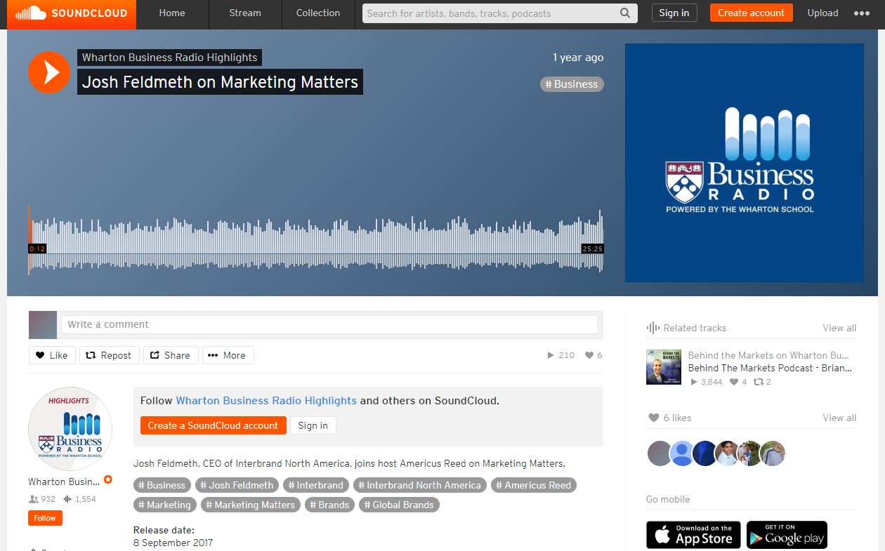
Podcast Pause
Originally aired on Business Radio powered by Wharton

Slide 25
Podcast Pause
John Feldmeth- CEO of Interbrand North America, rates and reviews the best global brands
Your brand can be viewed as an asset. It has quantifiable economic value
How brands are built today is different. Brands are now outcomes of extraordinary experiences. “This is who I am, believe in me”
Many of the brands on the list are defined as “cohesive businesses” and are growing much faster
Ecosystem effects
Consistent narrative
Connective experiences
We are moving into the age of “you”- our brand experiences will be user defined, e.g., Amazon
Lego (great brand experience), Nissan (products are synced with customer insights), and GE (reinventing itself and investing in technology) are among the top global brands. Betterment (great user interface, empowering your 401K) and Warby Parker (great experience, price, product) are breakthrough brands to keep your eye on
Originally aired on Business Radio powered by Wharton

Slide 26
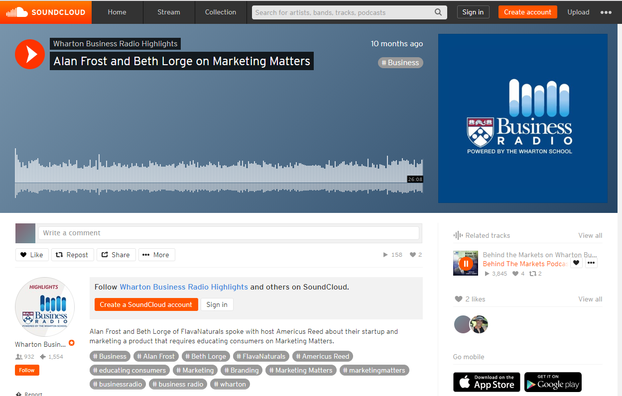
Podcast Pause
Originally aired on Business Radio powered by Wharton

Slide 27
Podcast Pause
Chocolate is actually good for you! Studies show that the flavanols in cocoa can promote healthy blood vessel function leading to improved brain, heart, and skin health
Wharton Alums Alan Frost and Beth Lorge started Flavanaturals, a company serving up healthy ways to get beneficial doses of flavanols
Their bars contain 5x and their drink mix contains 9x the flavanols of a dark chocolate bar
How do we rethink chocolate? 74% of people want chocolate daily. It’s not just on occasion or for a special event. “Chocolate was your weakness. Now it’s your strength!”
Flavanaturals is marketed towards several groups. From the health conscious to those that want to indulge in a chocolate bar, across age groups
Influencers and a strong social media presence is key. Brand advocates are needed to educate people on the benefits of flavanols
Originally aired on Business Radio powered by Wharton

Slide 28
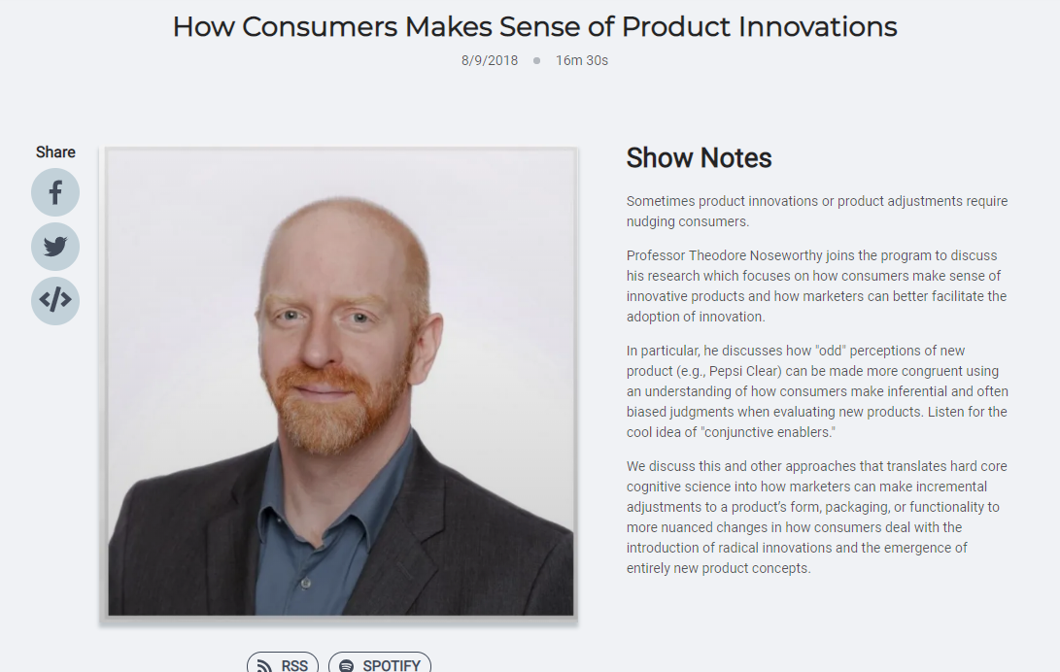
Podcast Pause
Originally aired on Business Radio powered by Wharton

Slide 29
Podcast Pause
“I don’t get it”- Sometimes a product has a value proposition that doesn’t make sense to consumers
Professor Noseworthy introduces us to conjunctive enablers-associations that help us connect these weird features to the product
Crystal Pepsi taste test- Cola is supposed to be brown, so why is it this clear? When the conjunctive enabler that it’s clear because it’s made with spring water was introduced, it made sense and participants liked it as much as the regular cola
Pre-testing can help marketers determine if their new product could use the help of conjunctive enablers when it goes to market
Can conjunctive enablers help us accept carbonated milk?
Originally aired on Business Radio powered by Wharton

Slide 30
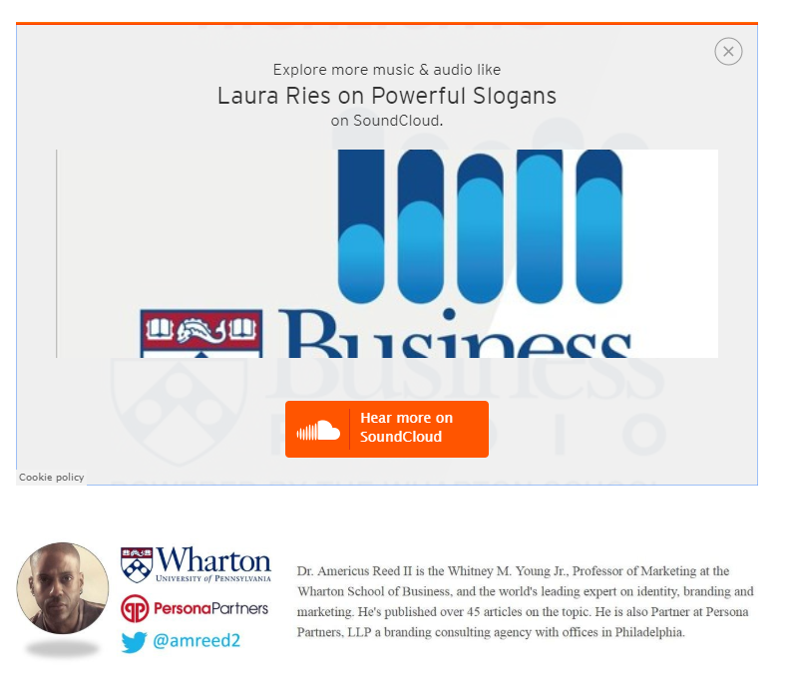
Podcast Pause
Originally aired on Business Radio powered by Wharton

Slide 31
Podcast Pause
The goal of marketing is to get inside the mind of the consumer. Laura Ries notes that providing a memorable visual and catchy slogan can help you win the battle
Visuals help drive your idea into people’s minds so that they remember it
A slogan is your brand’s battle cry. It defines who you are in a powerful and positive way. Here’s five techniques to consider when developing your slogan:
Rhyme-”If it fits, it ships”
Alliteration- Toys for Tots
Repetition-”Pizza! Pizza!”
Reversals-”Flame-broiled, not fried”
Double-Entendre- “A Diamond is Forever”
Word of mouth has always been key in spreading your message, but today we have more powerful ways to communicate. “Word of mouth used to be about people talking at the watercooler, but now it’s sharing and posting things on Facebook and Snapchat”
Originally aired on Business Radio powered by Wharton

Slide 32
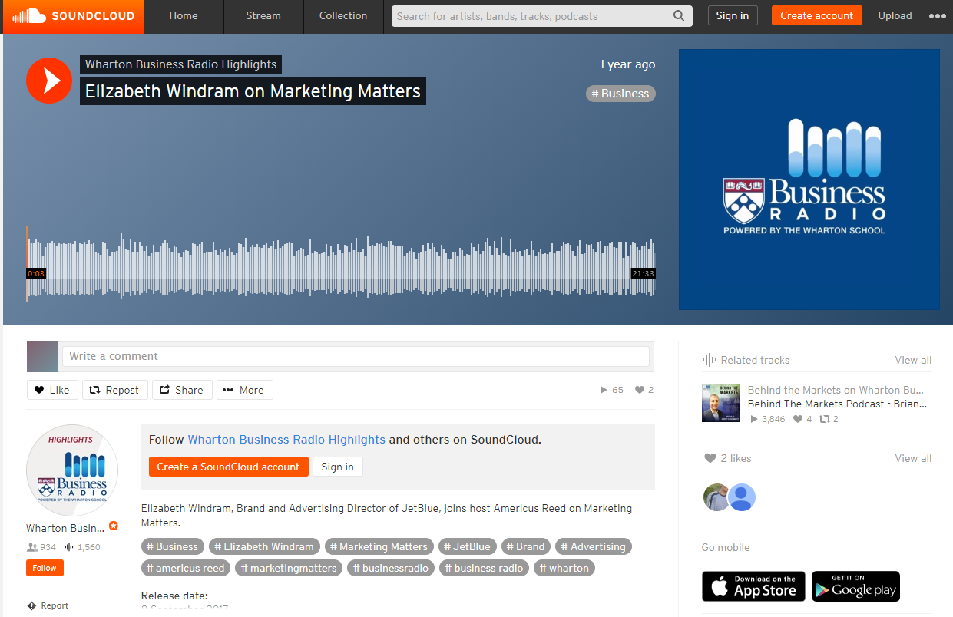
Podcast Pause
Originally aired on Business Radio powered by Wharton

Slide 33
Podcast Pause
Wharton Alum Elizabeth Windram has been the force behind some brands that have focused on differentiation
She led the charge to bring Barefoot wines (E and J Gallo) to market in attempts to shed the pretentiousness in this category
70% of people drink alcohol, but only 33% drink wine
They made it more fun and accessible for people to enjoy wine
Now she drives the messages for Jet Blue, focusing on delivering excellent customer service at every touchpoint to every person
Air industry need to be more than just a price point and route
“Love at first flight”
“Fly Babies” and “Reach Across the Aisle” are purpose driven ad campaigns, turning negativity into something positive
Originally aired on Business Radio powered by Wharton

Slide 34
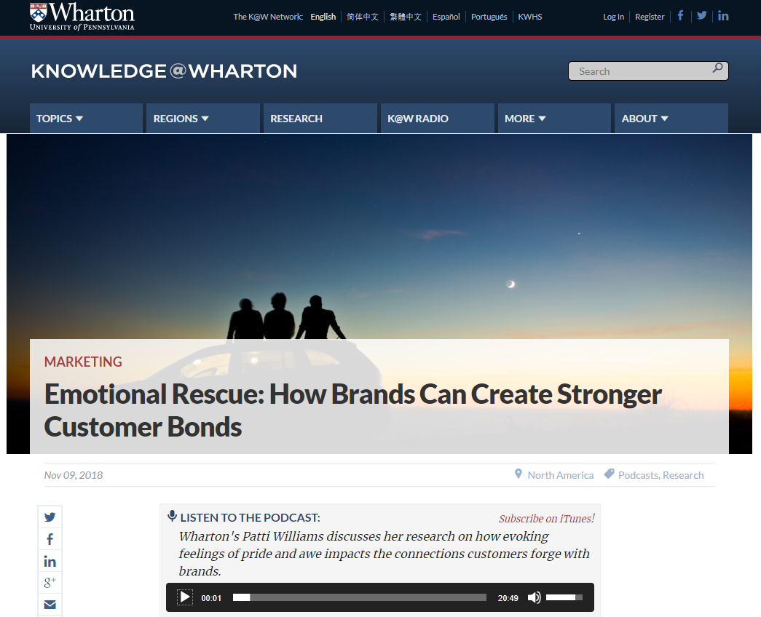
Podcast Pause
Originally aired on Business Radio powered by Wharton

Slide 35
Podcast Pause
Professor Patti Williams looks at how the feelings of awe and pride can evoke a deeper connection with brands
Awe is about making a bigger connection with the world around you, looking outside of yourself. Awe is associated with social benefit brands, e.g., United by Blue
In contrast, pride is sense of personal accomplishment, expanding and enhancing your sense of self. Pride is associated with luxury brands, e.g., Louis Vuitton
Emotions really have an impact on the kinds of relationships that consumers have with brands. Brands need to think beyond positive emotions versus negative emotions, understanding that not all positive emotions have the same impact.
Originally aired on Business Radio powered by Wharton

Slide 36
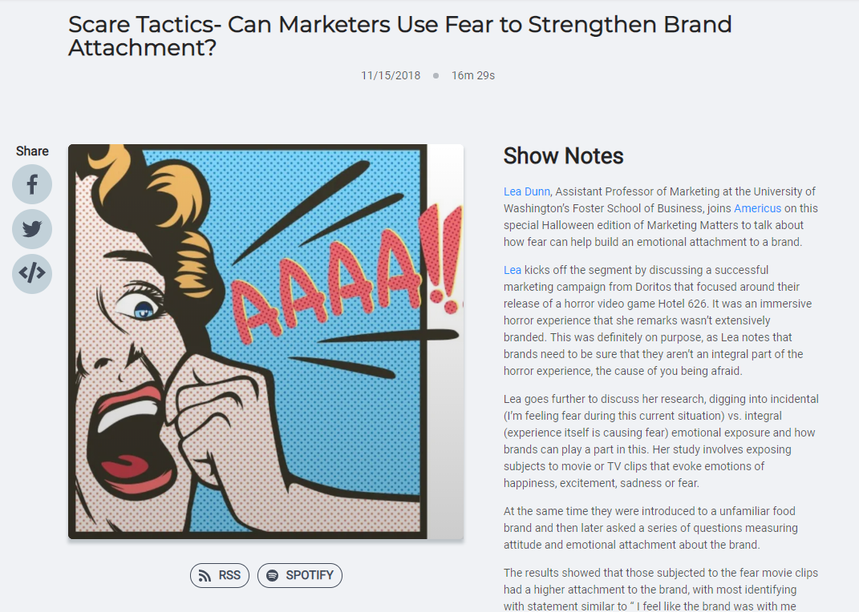
Podcast Pause
Originally aired on Business Radio powered by Wharton

Slide 37
Podcast Pause
Marketers can use fear to help build an emotional attachment to a brand
BUT…brands need to be sure that they aren’t an integral part of the horror experience, the cause of you being afraid
A study by Lea Dunn tested incidental (I’m feeling fear during this current situation) vs. integral (experience itself is causing fear) emotional exposure and how brands can play a part in this
When first introduced to a brand, then exposed to a horror movie clip, subjects gained an attachment to the brand with most identifying with statement similar to “ I feel like the brand was with me during the experience”
Originally aired on Business Radio powered by Wharton

Slide 38
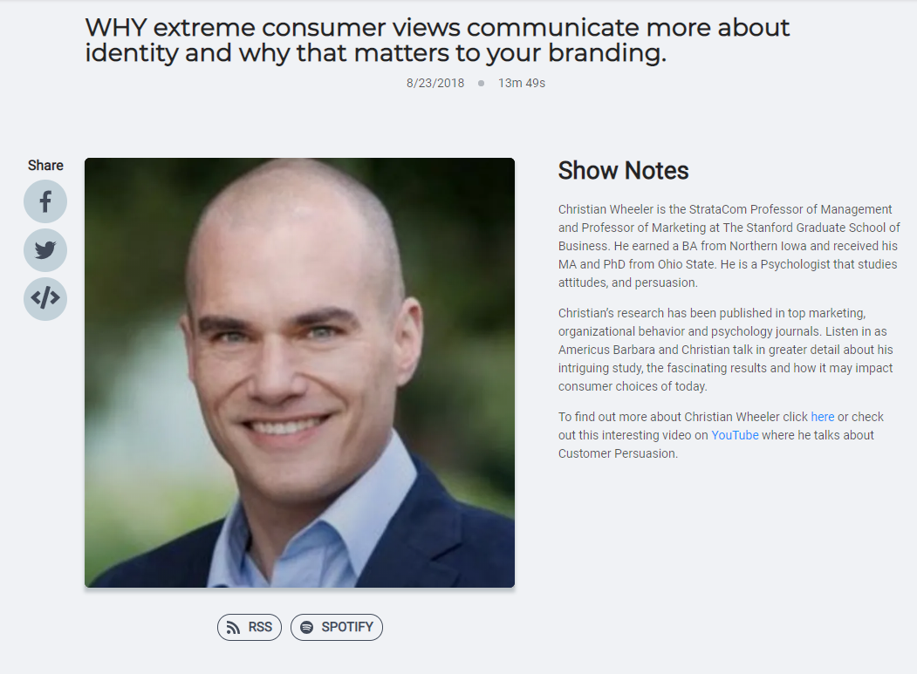
Podcast Pause
Originally aired on Business Radio powered by Wharton

Slide 39
Podcast Pause
Christian Wheeler talks about his study focusing on people’s preference hen people prefer polarizing products
A polarizing product is something you either love or hate, no in-betweens
The research found that polarizing products are preferred when people feel they lack a clear identity or need to be more self expressive
Polarizing brands have the haters, but this effect can be outweighed by those who advocate for your brand, a walking brand evangelist
When it comes to product reviews, these polarizing reviews tend to lower the mean product rating but Christian advocates that consumers should consider other factors when looking at reviews such as who is giving the ratings
Originally aired on Business Radio powered by Wharton

Slide 40
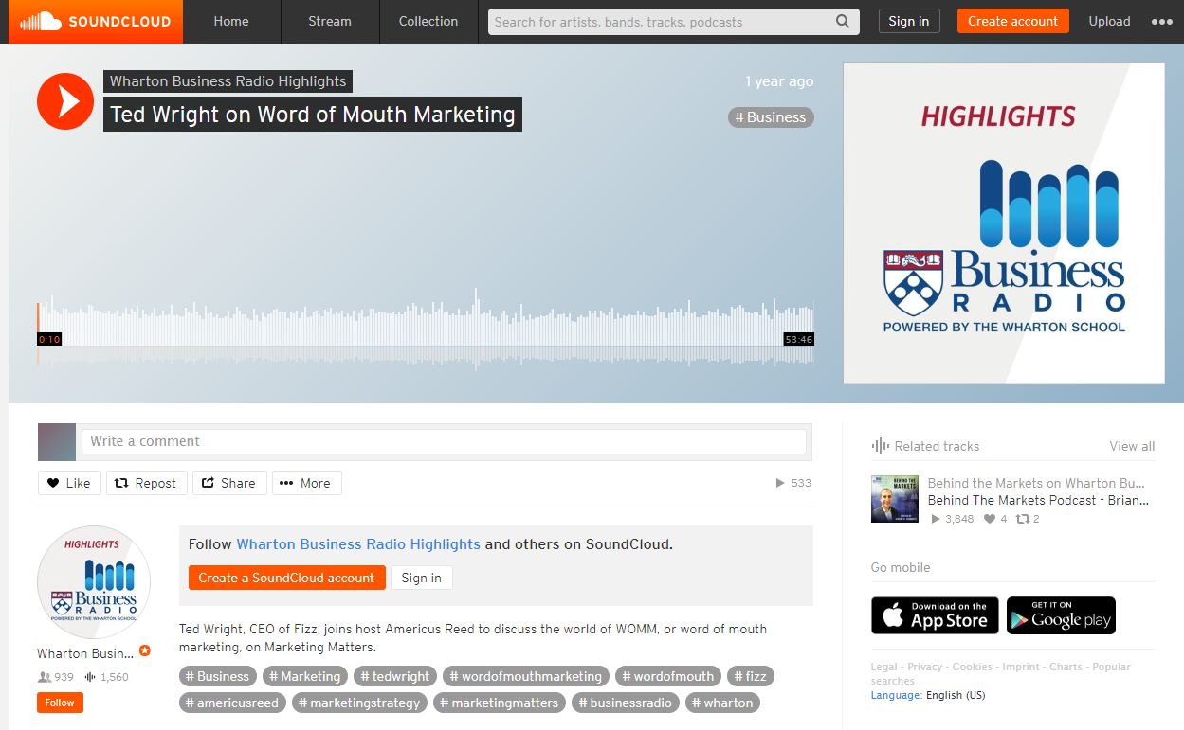
Podcast Pause
Originally aired on Business Radio powered by Wharton

Slide 41
Podcast Pause
Ted Wright- The Guru of WOMM (Word of Mouth Marketing) and a pretty funny guy
WOM is probably the oldest and most successful method of marketing
Influencers are key to your WOM strategy
An influencer is worth 40,000 shares per individual per year
Influencers like to try new things because they are new, like to share stories with their friends, and are intrinsically motivated
Influencers are generally most interested in 3 or fewer categories
Brands never find influencers- the influencers find them
Influencers will share your story if the story is interesting to them, is relevant to their audience, and is authentic to the way they understand your brand
ROLL UP THE ATM!- WOM will always work if you create the most interesting, relevant, and authentic story and share it in such a way that makes it easy for influencers to pick up and share with other people
Originally aired on Business Radio powered by Wharton

Slide 42
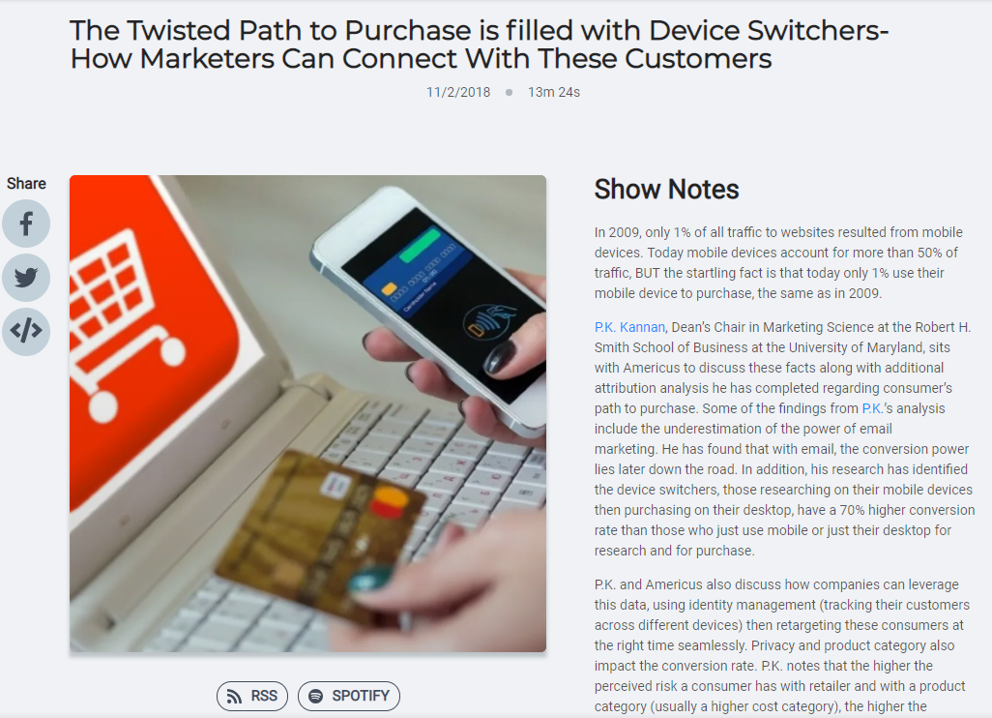
Podcast Pause
Originally aired on Business Radio powered by Wharton

Slide 43
Podcast Pause
Today we are so connected to our phones, but we still prefer to use our computers to buy things online
2009-1% of traffic to websites from mobile devices, 1% purchases from mobile devices
Today-50% of traffic, but still only 1% of purchases
P.K. Kannan takes a look at this and attribution analysis regarding the customer’s path to purchase
Device switchers- those that research on mobile devices then buy on their desktop have a 70% higher conversion rate than those who just use mobile or just their desktop for research and for purchase
Privacy and product category also impact the conversion rate. The higher the perceived risk a consumer has with retailer and with a product category (usually a higher cost category), the higher the likelihood that they device switch
Originally aired on Business Radio powered by Wharton

Slide 44
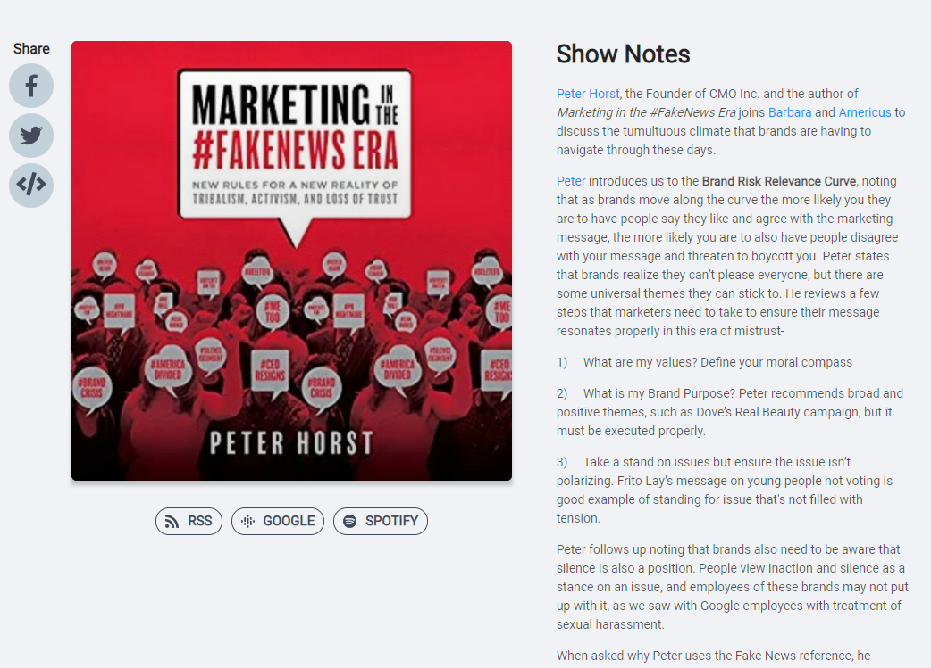
Podcast Pause
Originally aired on Business Radio powered by Wharton

Slide 45
Podcast Pause
Peter Horst-Author of Marketing In The #FakeNews Era
Brand Risk Relevance Curve- The more people that resonate with your brand message and support your mission brings just as many people that disagree with your message and threaten to boycott you
Steps to make sure your message resonates
What are my values? Define your moral compass
What is my brand purpose? E.g.- Dove’s Real Beauty campaign
Take a stand on issues, but make sure the issue isn’t polarizing. E.g.- getting out the vote
Inaction and silence is also a position on issues
Brands need to be sure their message is genuine and authentic. People will call out the bandwagon joiners of the purpose driven marketing movement
Originally aired on Business Radio powered by Wharton

Slide 46
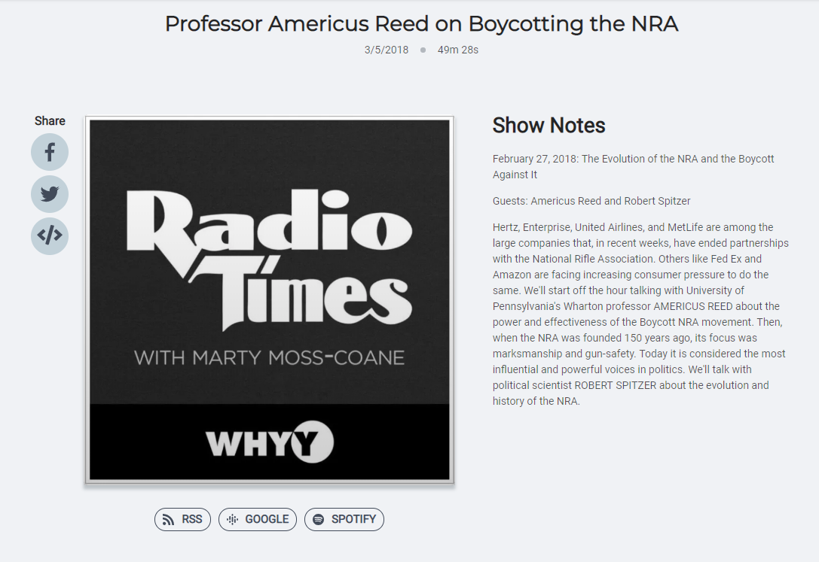
Podcast Pause
Originally aired on WHYY Radio

Slide 47
Podcast Pause
Social media is a huge component of a successful boycott and aids in the boycott sustainability
Companies can no longer hide- consumers want to know if their values align with the brands they support
The power of the anecdotal example- high school students taking to social asking for policy change sends a very powerful message
Brands have to make a calculated decision to possible alienate a certain group of consumers
Potentially 6 million NRA members
Fed Ex- walking a fine line with their stance taking a neutral position, not denying NRA service, but has clear views on gun policy issues
Companies that take a stance are seen more credible
Boycott backlash-it is possible that some consumers will not patronize these businesses that have cut ties with the NRA?
Will consumers inconvenience themselves to stand up for what they believe? Are they willing to talk with their wallets?
Consumers have clout!
Originally aired on WHYY Radio

Slide 48
Class Exercises

